Slide 1

Market ANALYSIS
Presentation by campbell olawale oladimeji

Slide 2
Introduction
This report provides an analysis of data using Python, focusing on key aspects such as data cleaning, transformation, and visualization. The objective is to demonstrate how Python can be effectively utilized for data analysis and reporting. The datasets encompasses various campaigns across categories such as social media, search engines, influencers and media partnerships. The focus of the analysis is to provide actionable insights to optimize future campaigns, improve Returns on Investment and by leveraging libraries like Pandas and Matplotlib, the report examines patterns, trends, and insights that can aid decision-making.

Slide 3
Objective of the Report
The objective of this report is to analyze campaign performance using data-driven techniques. By querying and processing campaign-related data, this report aims to:
Extract Key Campaign Information – Retrieve campaign names, categories, and other essential attributes to understand the dataset.
Analyze Campaign Performance – Identify high-performing campaigns based on revenue, clicks, leads, and impressions.
Categorize Campaigns – Group campaigns by category and evaluate their contribution to overall performance.
Measure Financial Efficiency – Compare revenue against spending to determine campaign profitability.
Evaluate User Engagement – Analyze clicks and leads to understand audience interaction and campaign effectiveness.
Identify Top-Performing Campaigns – Determine the highest revenue-generating and most engaging campaigns.
Summarize Key Metrics – Calculate total revenue, average spending, and other aggregated insights for a comprehensive performance overview.
This report provides valuable insights into campaign success factors, helping optimize marketing strategies for better results.

Slide 4
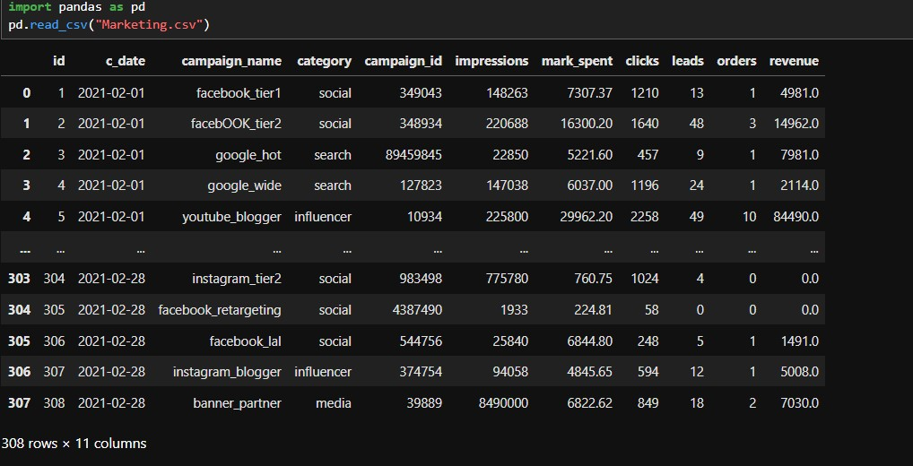
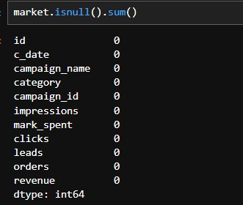
Importing the Dataset & Handling Missing Values
The first step is to import necessary libraries and load the dataset.
The dataset was imported using pd.read_csv.
It consisted of 308 rows and 11 columns
----------------------------------------------------------
Market.isnull().sum() was used to identify missing values in each column.
From the result of the syntax there was no missing value.

Slide 5
Visualization & Analysis
1. Bar Chart - "Total Orders by Category“ X-axis: Represents different categories (influencer, media, search, social).- *Y-axis:* Represents the number of orders in each category.- *Color:* The bars are blue, and there is a legend labeled "orders.“
*Observations:- The social category has the highest number of orders (~2,800+). - The influencer category also has a high number of orders (~2,800). - Media has a moderate number of orders (~1,500). - Search has the lowest number of orders (~800).
Insights:Social and Influencer channels drive the most orders, indicating they are strong performers in terms of engagement.
2. Line Chart: “Total Market Spent by Campaign”.This line chart visualizes the total amount spent on different campaigns. The x-axis represents campaign names, while the y-axis represents market spending. The red line represents the trend of spending across different campaigns.
Observations:The influencer category generated 3,014 orders.
Insights:- The influencer category is performing well, generating a significant number of orders.

Slide 6
1. Bar Chart -"Total Revenue by Date"*- *X-axis:* Dates (c_date), covering the month of February 2021.- *Y-axis:* Total revenue in millions.-
Observations:The revenue trend shows fluctuations, with a steady increase until around February 20-21, where it peaks at over 5 million. - After the peak, revenue drops significantly towards the end of the month. The table summarizes the total clicks for two categories: - Influencer:749,973 clicks Media: 420,003 clicks
Insights: There was a strong growth in revenue until the third week of February, followed by a sharp decline.- This could indicate the impact of marketing campaigns, seasonality, or specific events driving sales. Influencer marketing generated more clicks than media.This suggests that influencer campaigns are more engaging.
2. Bar Chart - Total Impressions by Campaign Name“ X-axis: Different campaign names (banner_partner, facebook_tier2, facebook_lal, google_wide, instagram_tier2, youtube_blogger, etc.). - Y-axis: Number of impressions (in billions)
Observations: - The banner_partner" campaign has the highest impressions, exceeding 1 billion. - Other campaigns, including Facebook, Google, Instagram, and YouTube, have significantly lower impressions in comparison.
Insights: Campaigns on Facebook, Instagram, and YouTube have smaller impressions, possibly indicating lower reach or targeted audiences. - If impressions correlate with engagement, scaling successful campaigns could increase overall performance.

Slide 7
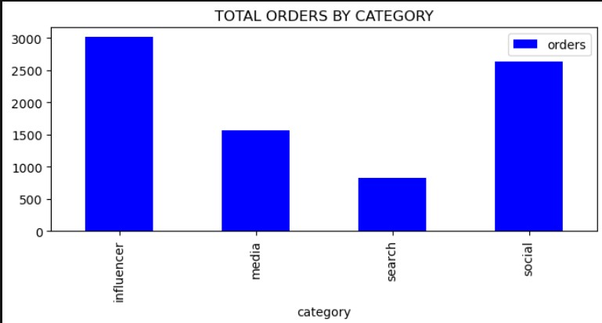
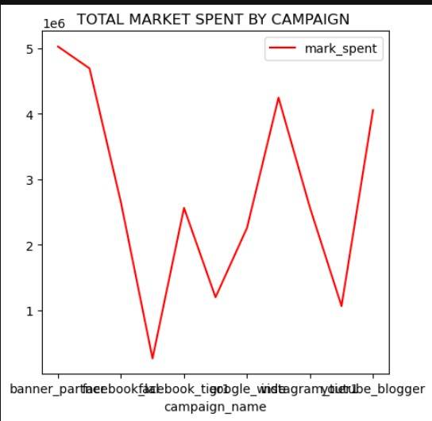
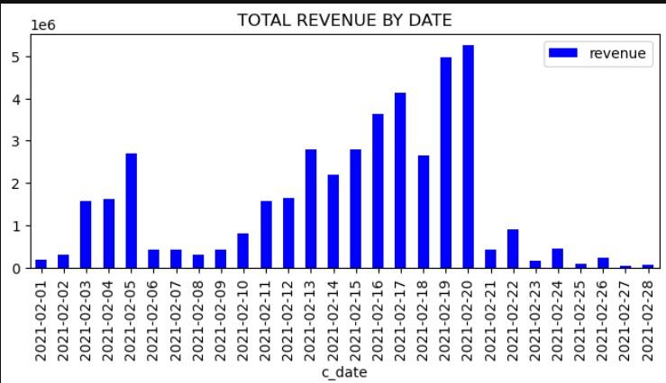
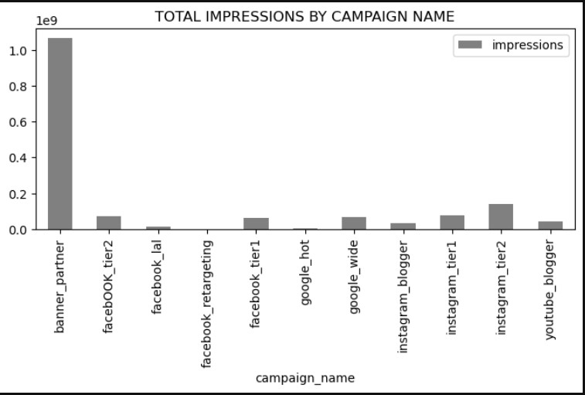

Slide 8
Recommendation
1 Optimize Budget Allocation- Shift more budget to cost-efficient campaigns that generate high impressions with lower spending. - Reduce spending on campaigns with high costs but low impressions.
2. Leverage High-Performing Campaigns- The banner_partner campaign has the highest impressions. If it also converts well, consider scaling it further- If influencer and media campaigns drive more clicks, prioritize them in marketing efforts.
3.Improve Low-Performing Channels- Facebook, Instagram, and YouTube campaigns have lower impressions. Optimize their targeting, content, and ad placements to increase reach.Test different creatives, audience segments, and ad formats to improve performance.
4.Analyze Revenue vs. Marketing Spend- Correlate marketing spend with revenue and conversions to see which campaigns drive actual sales.If a high-impression campaign doesn’t translate into revenue,adjust targeting or optimize landing pages.
5. Investigate Revenue Drop Post-Peak- February 20-21 saw peak revenue, followed by a sharp decline. Identify what drove the spike (promotions, influencer activity) and replicate successful strategies.

Slide 9
Conclusion
Conclusion -Banner Partner dominates impressions, but further analysis is needed to determine if it drives revenue. - Influencer marketing is highly engaging (highest clicks), suggesting it could be a strong driver of conversions. - Marketing spend should be re-evaluated to maximize ROI by focusing on campaigns that bring both impressions and revenue. Future actions should focus on testing, scaling high-performing campaigns, and optimizing underperforming ones for better cost efficiency.

